Slide 1
Diagrams used on integration overview articles

Slide 2














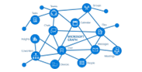


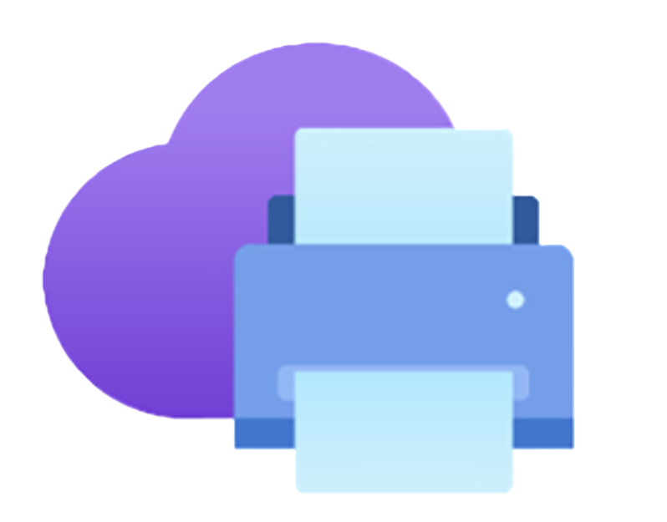


Connect apps
Microsoft Apps
Microsoft Appsource
Business Central
Power Platform
Microsoft 365
Microsoft Azure
Microsoft foundational services
Dynamics 365

Slide 3
Microsoft 365
Business Central

Slide 4
Microsoft Word
Microsoft Excel
Business Central
Microsoft Outlook
Microsoft Teams
Onedrive for Business
Microsoft SharePoint
Microsoft Graph

Slide 5
Business Central
Power Platform

Slide 6
Business Central
Dynamics 365

Slide 7
Microsoft Azure
Business Central

Slide 8







A complete, unified suite of leading CRM and ERP applications
Dynamics 365
Business Central
Dynamics 365 Sales
Dynamics 365 Customer Service
Dynamics 365
Field Service
Dynamics 365 Customer Insights
Dynamics 365 Finance
Dynamics 365
Supply Chain Management
Notes:
And that has been true for our business as well. We have been leading the way with Copilots in every Dynamics 365 application – making every application from business central to sales, service, finance, and supply chain management - the democratizing force that empowers every business to dramatically boost productivity through seamlessly infused AI workflows. And for that purpose, we have introduced Dynamics 365 Copilot, as the world’s first AI copilot natively built-in to both CRM and ERP applications.
Let’s roll the video…

Slide 9




Business Central differentiation: AI and Collaboration
Unmatched experiences built on the broad Microsoft ecosystem
Microsoft 365
Business Central
Power Platform
Microsoft Dynamics 365 Copilot

